Slide 1
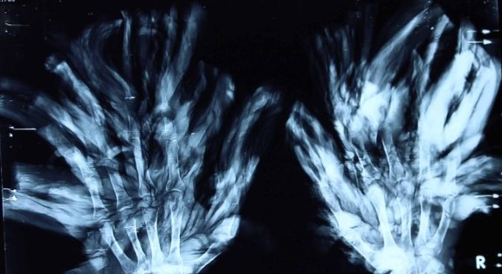
Epidermodysplasia verruciformis
Treeman Syndrome
Stephen Ortmann

Slide 2
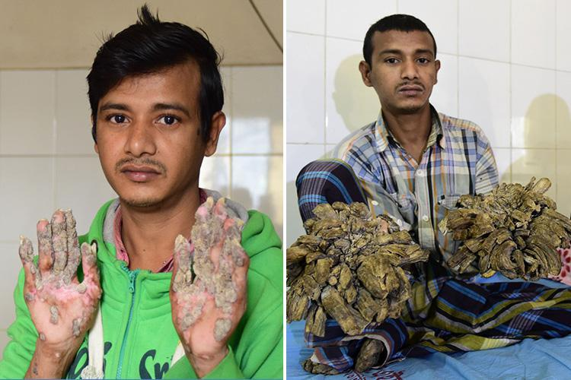
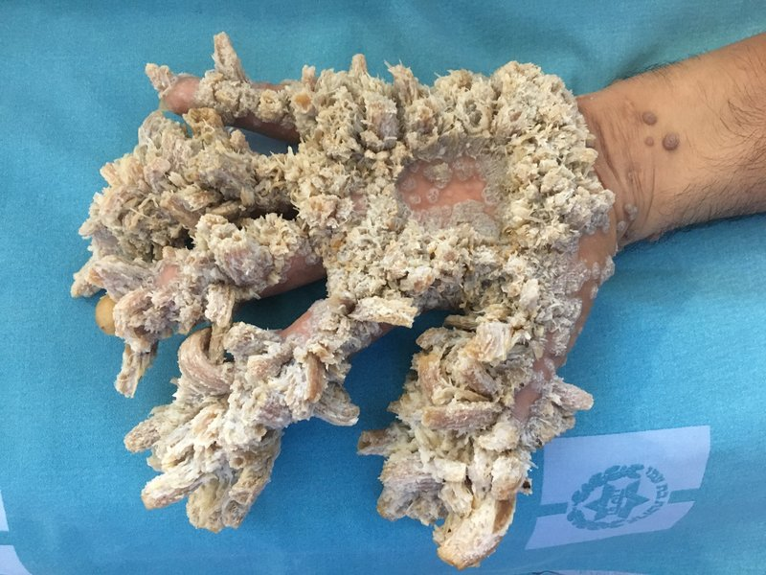
What is Tree man syndrome (EV)?
What causes warts?

Slide 3
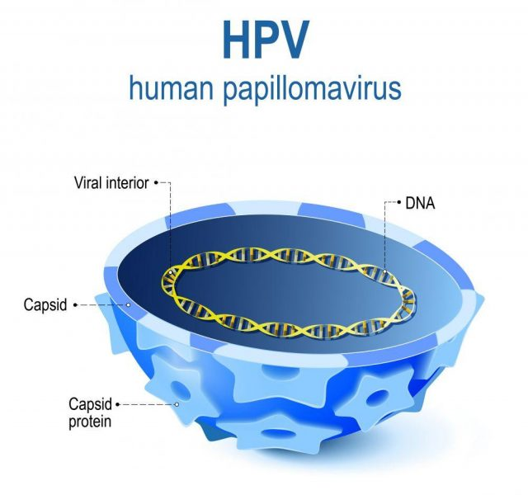
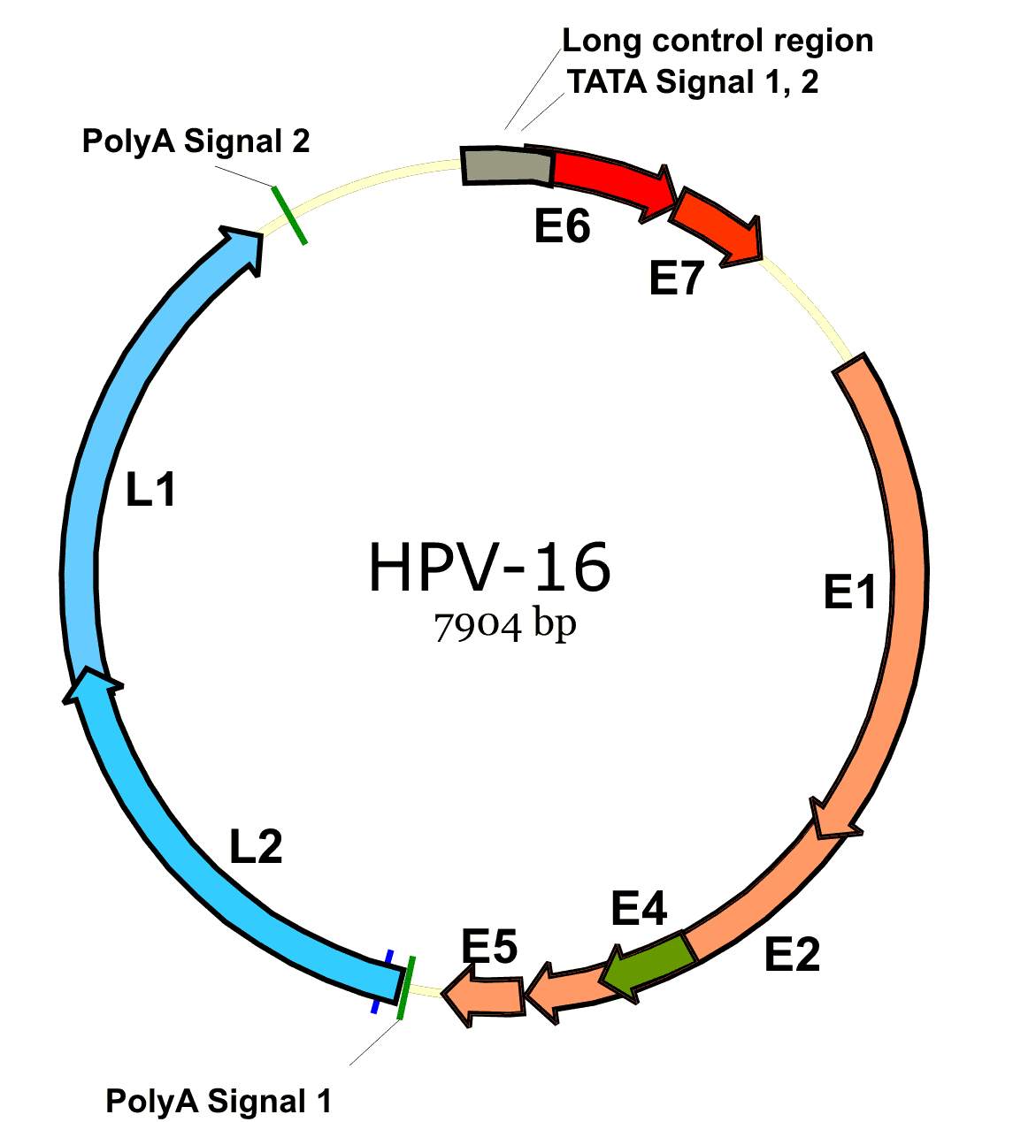
What is Human papillomavirus (HPV)?

Slide 4
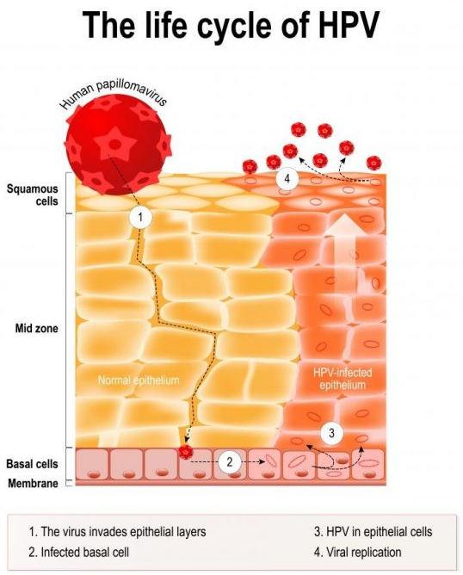
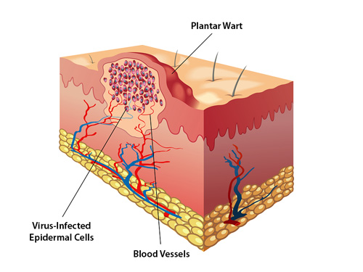
Warts

Slide 5
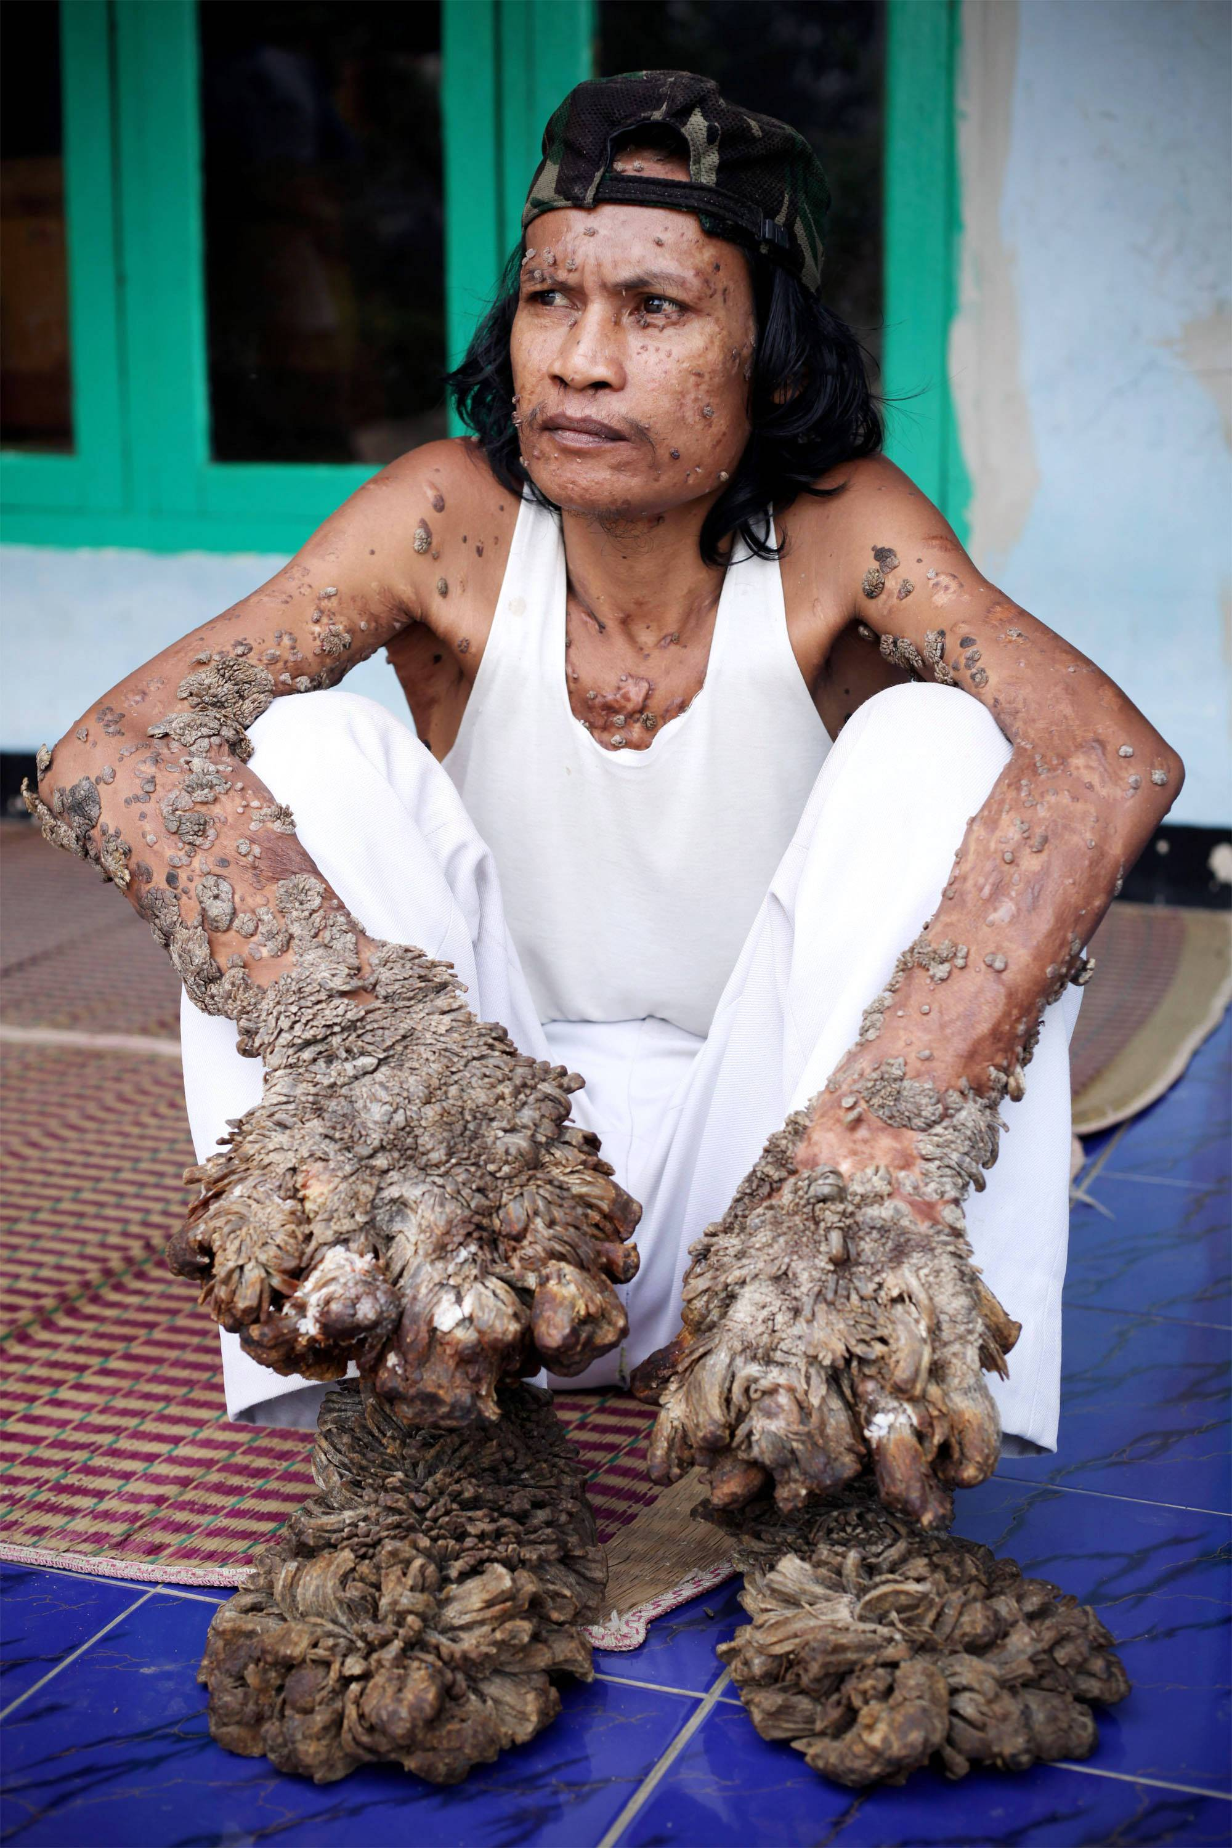
Warts

Slide 6
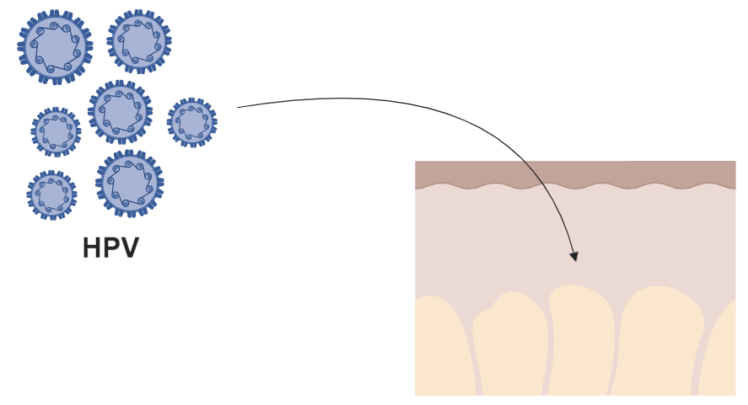
What causes this difference?
Skin

Slide 7
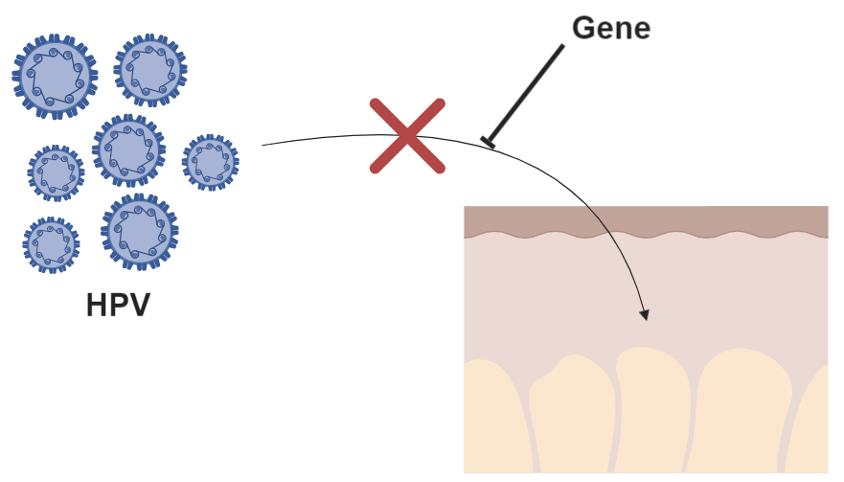
What causes this difference?
Skin

Slide 8
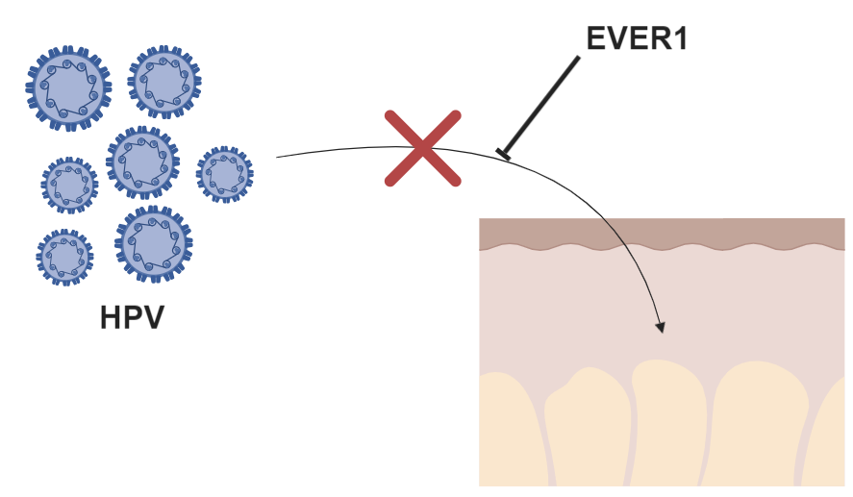
What causes this difference?
Skin

Slide 9
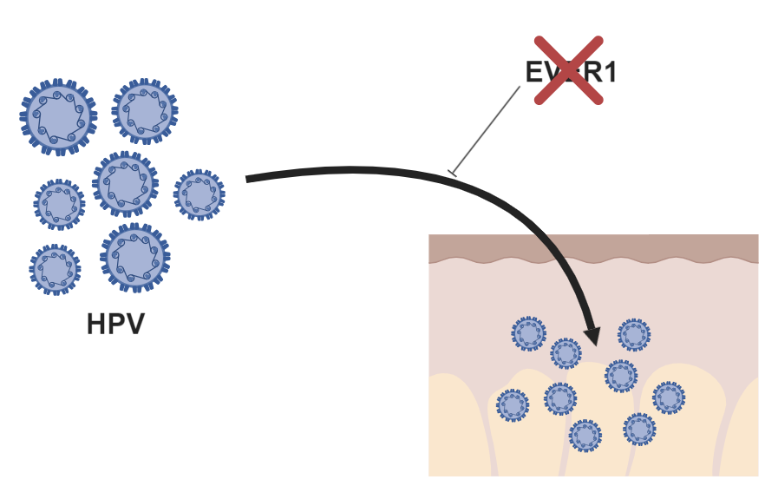
What causes this difference?
Virus-infected Skin

Slide 13
What is EVER1 Phylogeny?
Is EVER1 conserved?

Slide 14
TMC
Humans - 805aa (100%)
TMC
Chimpanzees - 805aa (98.76%)
TMC
Mice - 810aa (75%)
TMC
Dogs - 813aa (76.45%)
TMC
Cattle - 769aa (77.47%)
TMC
Zebrafish - 826aa (38.11%)
TMC
C. elegans - 1285aa (26%)

Slide 15
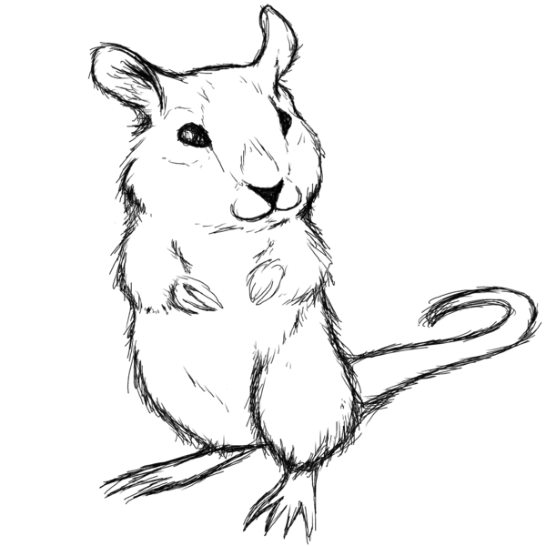
Why use mice?

Slide 16
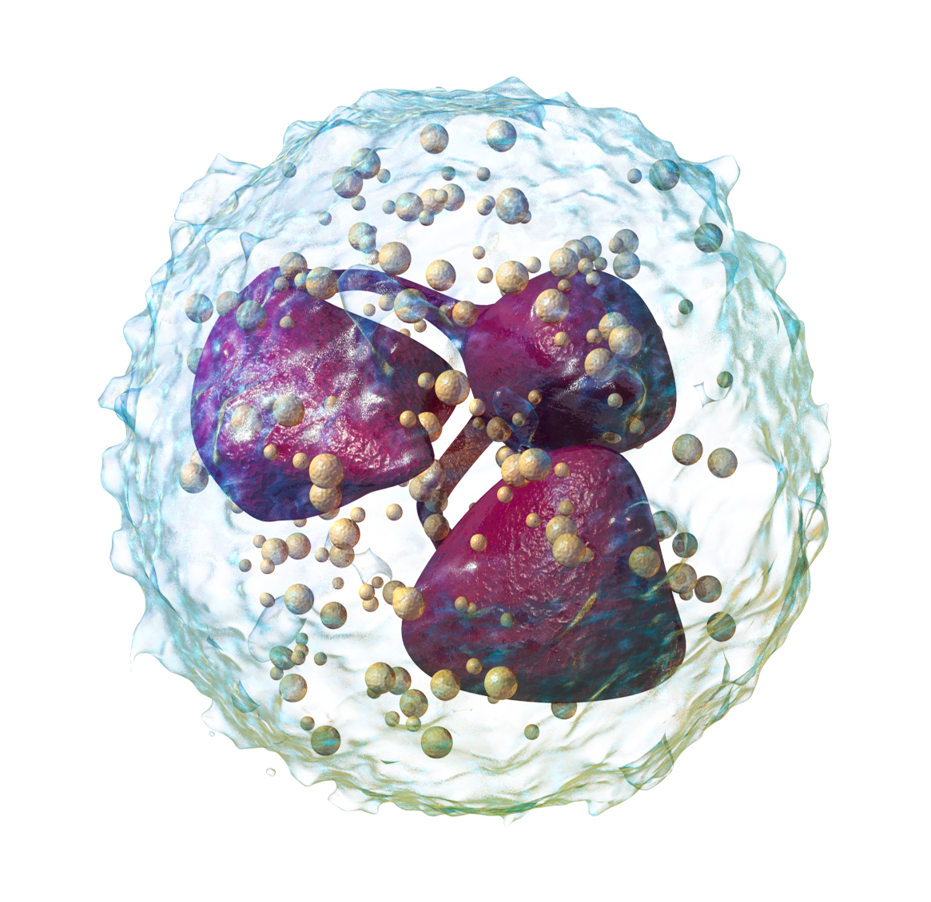
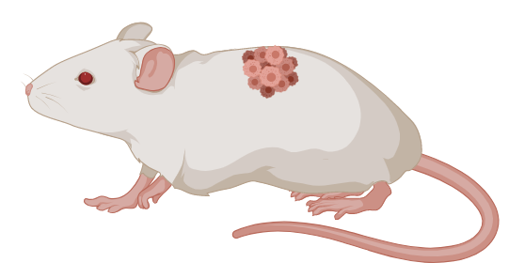
Innate Immunity
Tumor Progression
How does EVER1 interact in vivo?

Slide 18
TMC6 protein interactions in mice
Direct line of interaction from TMC6 to Cib1
UBR4: Ubiquination
Cry2: Involved in the circadian rhythm and sensitive to blue-light
Circadian Rhythm

Slide 19
What don’t we know?

Slide 20
How does EVER1 aid in innate immunity?

Slide 21
What is the primary goal?
Aim 1 |  | Aim 2 |  | Aim 3
Determine conserved amino acids between the homologous organisms and use CRISPR/CAS9 to create mutant mice using these conserved regions |  | Identify new genes important for innate immunity to HPV by using RNA-seq to see differentially expressed genes in response to viral entry |  | Identify new proteins involved in cellular proliferation and innate immunity by quantifying protein levels in response to blue-light and viral entry
To understand TMC6’s role in innate immunity to HPV, and consequently, its role on cell proliferation

Slide 22
What is the primary goal?
Aim 1 |  | Aim 2 |  | Aim 3
Determine conserved amino acids between the homologous organisms and use CRISPR/CAS9 to create mutant mice using these conserved regions |  | Identify new genes important for innate immunity to HPV by using RNA-seq to see differentially expressed genes in response to viral entry |  | Identify new proteins involved in cellular proliferation and innate immunity by quantifying protein levels in response to blue-light and viral entry
To understand TMC6’s role in innate immunity to HPV, and consequently, its role on cell proliferation

Slide 23
What is the primary goal?
Aim 1 |  | Aim 2 |  | Aim 3
Determine conserved amino acids between the homologous organisms and use CRISPR/CAS9 to create mutant mice using these conserved regions |  | Identify new genes important for innate immunity to HPV by using RNA-seq to see differentially expressed genes in response to viral entry |  | Identify new proteins involved in cellular proliferation and innate immunity by quantifying protein levels in response to blue-light and viral entry
To understand TMC6’s role in innate immunity to HPV, and consequently, its role on cell proliferation

Slide 24
What is the primary goal?
Aim 1 |  | Aim 2 |  | Aim 3
Determine conserved amino acids between the homologous organisms and use CRISPR/CAS9 to create mutant mice using these conserved regions |  | Identify new genes important for innate immunity to HPV by using RNA-seq to see differentially expressed genes in response to viral entry |  | Identify new proteins involved in cellular proliferation and innate immunity by quantifying protein levels in response to blue-light and viral entry
To understand TMC6’s role in innate immunity to HPV, and consequently, its role on cell proliferation

Slide 25
Aim 1: Identify conserved amino acids in EVER1
Hypothesis: That only conserved regions in mammals will be important for cell proliferation and innate immunity
CRISPR/Cas9
BLAST
Omega

Slide 26
Aim 1: Identify conserved amino acids in EVER1
Approach: Find amino acids that are conserved in skin-having organisms but are not conserved in non-skin-having organisms (C. elegans)
CRISPR/Cas9
BLAST
Omega

Slide 27
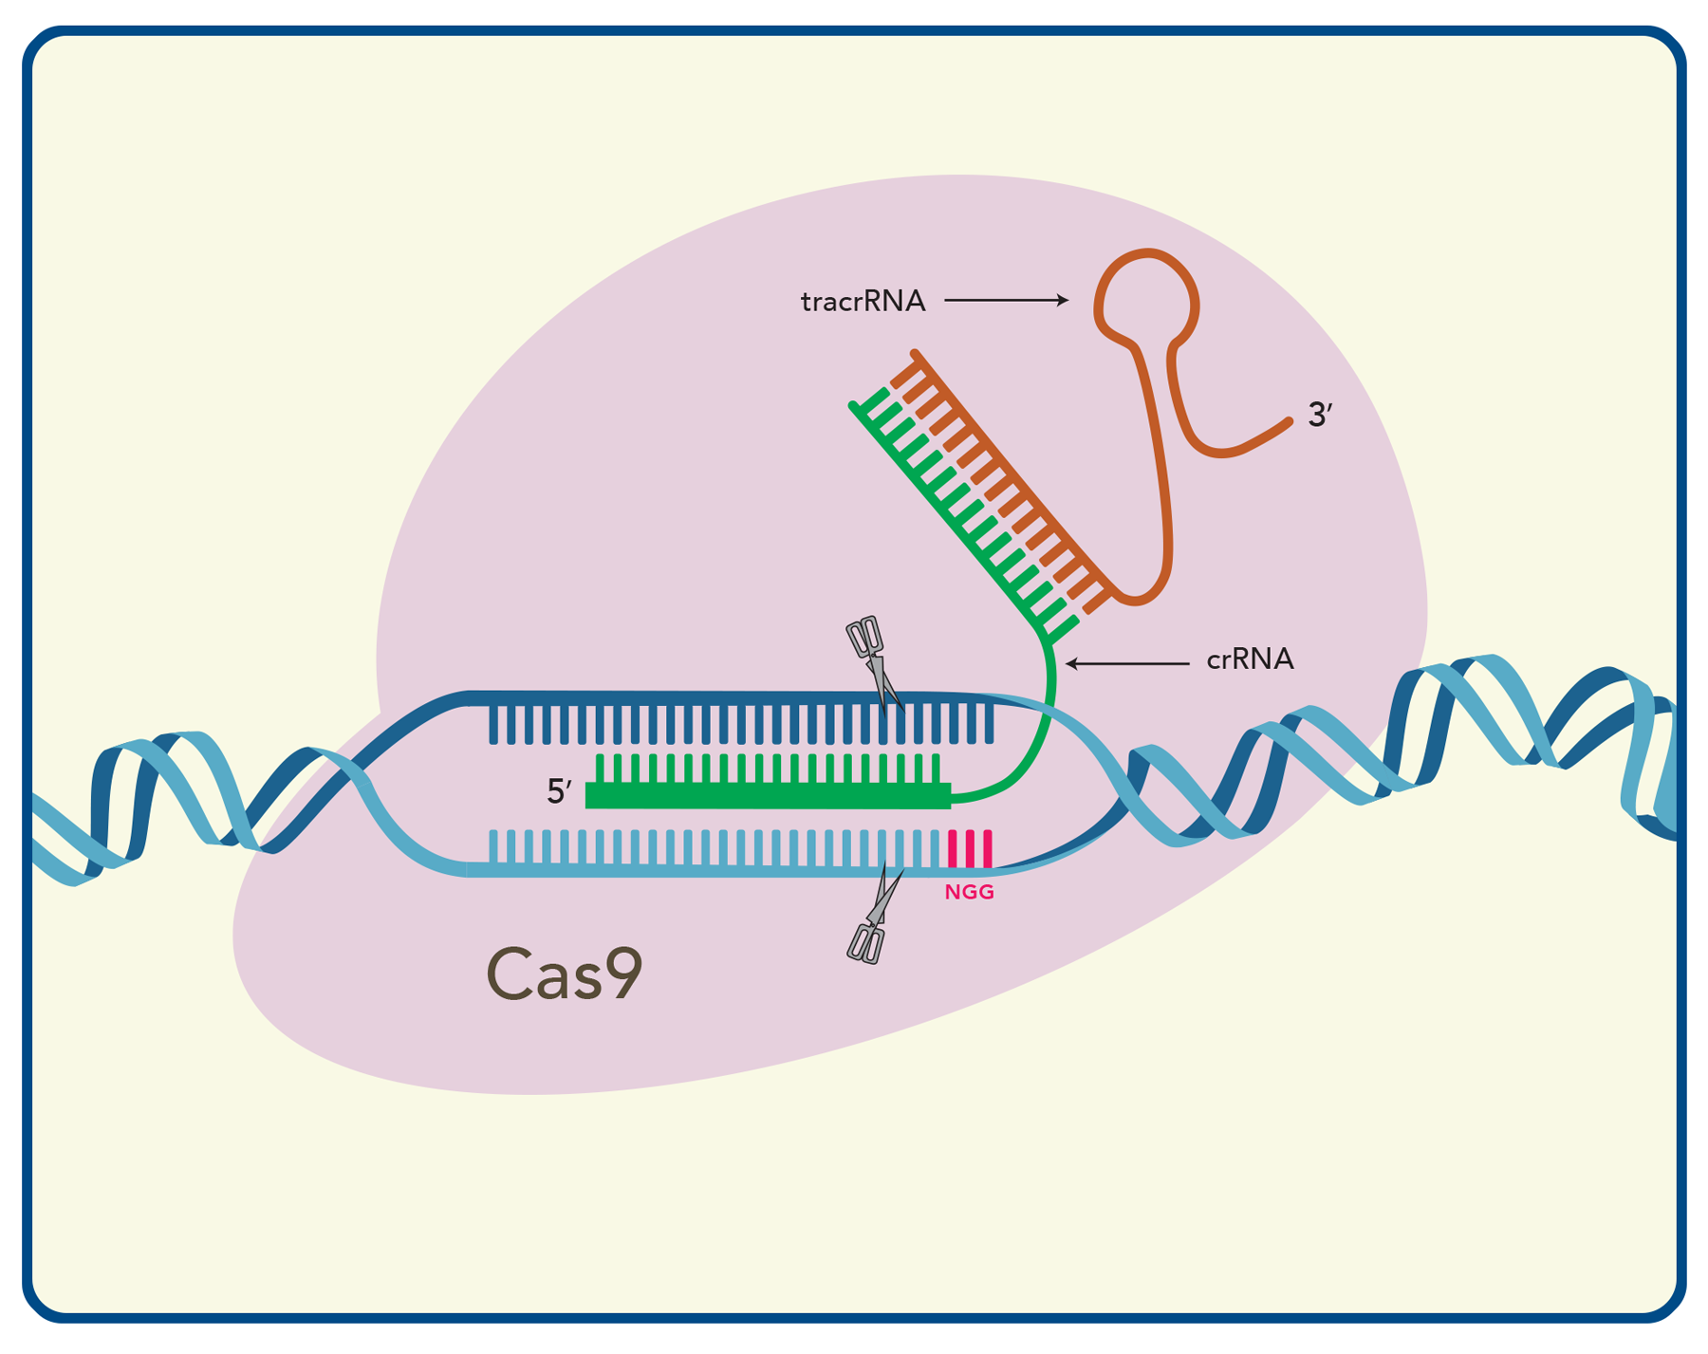
Aim 1: Identify conserved amino acids in EVER1
CRISPR/Cas9
BLAST
Omega

Slide 28
Aim 1: Identify conserved amino acids in EVER1
CRISPR/Cas9
BLAST
Omega

Slide 29
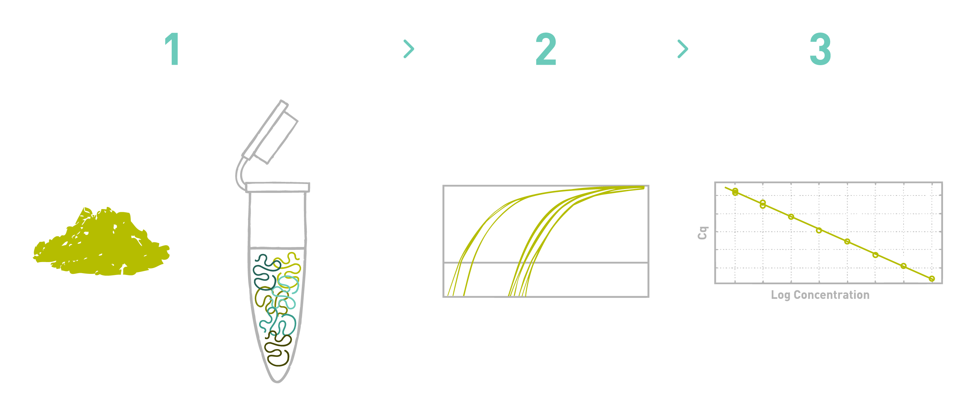
Aim 1: Identify conserved amino acids in EVER1
CRISPR/Cas9
BLAST
Omega

Slide 30
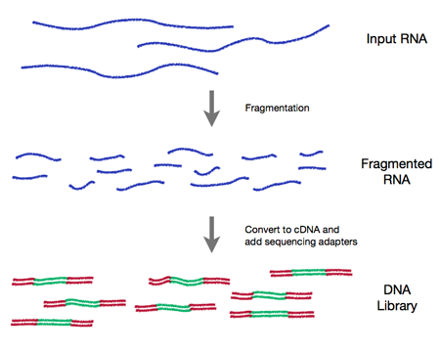
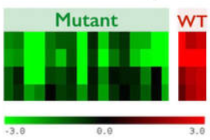
Aim 2: Determine differentially expressed genes
Hypothesis: EVER1 affects multiple genes which all play a role in innate immunity and cell proliferation
CRISPR/CAS9
RNA-seq
GO

Slide 31
Aim 2: Determine differentially expressed genes
CRISPR/CAS9
RNA-seq
GO

Slide 32
Aim 2: Determine differentially expressed genes
CRISPR/CAS9
RNA-seq
GO

Slide 33
Aim 3: Proteome changes in response to blue-light and virus infection
Hypothesis: Viral infections along with blue-light addition will alter the proteome in ways that dysregulate cellular proliferation and innate immunity

Slide 34
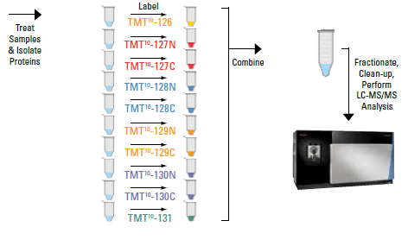
Aim 3: Proteome changes in response to blue-light and virus infection
Multiple samples mice with different mutations

Slide 35
Aim 3: Proteome changes in response to blue-light and virus infection
Innate Immunity
Circadian Rhythm

Slide 36
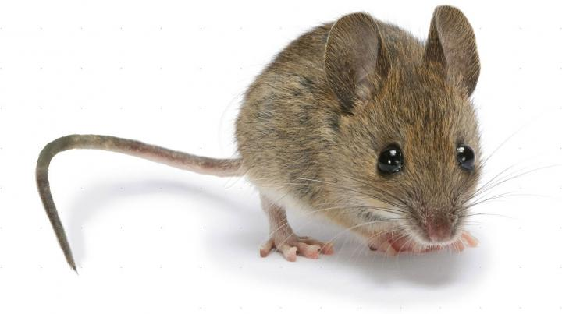
Conclusion
EV is a rare autosomal recessive disease that leads to persistent B-HPV infection, persistent scaly warts, and high susceptibility to develop SCC
A mouse model will be used to not only model HPV infection in keratinocytes, but also model SCC upon blue-light exposure
The goal of the project is to determine how EVER1 gives rise to innate immunity and consequently dysregulates cellular proliferation

Slide 38
Sources
https://www.google.com/url?sa=i&source=images&cd=&ved=2ahUKEwiHoJXdv-XhAhVGXK0KHaooAm0QjRx6BAgBEAU&url=http%3A%2F%2Fwww.wikiwand.com%2Fen%2FHuman_papillomavirus_infection&psig=AOvVaw3pg6sJIhpbIC0cV8y9xJHF&ust=1556084022861663
https://www.google.com/url?sa=i&source=images&cd=&cad=rja&uact=8&ved=2ahUKEwj2x4SWwOXhAhVHWq0KHQeYCnMQjhx6BAgBEAM&url=https%3A%2F%2Fwww.std-gov.org%2Fstds%2Fhuman_papillomavirus_hpv.htm&psig=AOvVaw1JO3rlgBSqwd8D-VIzmIAb&ust=1556084364431639
https://www.google.com/url?sa=i&source=images&cd=&cad=rja&uact=8&ved=2ahUKEwjlnJGMwuXhAhUFDKwKHZH3CAgQjhx6BAgBEAM&url=https%3A%2F%2Fwww.moyaltherapies.co.uk%2Four-thoughts%2Fan-overview-of-warts&psig=AOvVaw3nXpjID1DxjXqu7Pt9oUGf&ust=1556084892579445
https://www.google.com/url?sa=i&source=images&cd=&cad=rja&uact=8&ved=2ahUKEwimkPunwuXhAhUCd6wKHQkbB1cQjhx6BAgBEAM&url=https%3A%2F%2Fwww.medicalnewstoday.com%2Farticles%2F155039.php&psig=AOvVaw3Iv3KjFcLLjKcTYBEb6piq&ust=1556084927572611
https://www.google.com/url?sa=i&source=images&cd=&cad=rja&uact=8&ved=2ahUKEwj0l_3pwuXhAhUEP60KHRPrB6cQjhx6BAgBEAM&url=https%3A%2F%2Fwamu.org%2Fstory%2F17%2F09%2F01%2Frare-skin-disease-ruined-gaza-mans-life-until-israeli-doctors-stepped-in%2F&psig=AOvVaw119w75l-6y1lDBp_yGY9Om&ust=1556085066090591
https://www.google.com/url?sa=i&source=images&cd=&cad=rja&uact=8&ved=2ahUKEwjLqvSCxeXhAhUQKKwKHcDOCPQQjhx6BAgBEAM&url=http%3A%2F%2Fviralportal.net%2Fmeet-debe-koswara-a-k-a-the-human-tree-of-java%2F&psig=AOvVaw3SkEHWVnqE1BNPsZdLNN8b&ust=1556085671472009
https://www.google.com/url?sa=i&source=images&cd=&ved=2ahUKEwjdnJ3o4OXhAhVRUK0KHetQAx8Qjhx6BAgBEAM&url=https%3A%2F%2Fen.wikipedia.org%2Fwiki%2FNeutrophil&psig=AOvVaw2R-4Kcmt68jfrRAn5-vtRV&ust=1556093132887349
https://www.google.com/url?sa=i&source=images&cd=&cad=rja&uact=8&ved=2ahUKEwjnmNLG9uXhAhUSXa0KHUKoBfwQjhx6BAgBEAM&url=https%3A%2F%2Fwww.idtdna.com%2Fpages%2Feducation%2Fdecoded%2Farticle%2Fcrispr-genome-editing-5-considerations-for-target-site-selection&psig=AOvVaw0Fir6ZURB5ukG4LDuRQhWG&ust=1556098969586580
https://www.google.com/url?sa=i&source=images&cd=&cad=rja&uact=8&ved=2ahUKEwi7kqbZ_OXhAhVDEawKHUu6ASYQjhx6BAgBEAM&url=https%3A%2F%2Fwww.allgenetics.eu%2Findex.php%2Fservices%2Fgenomic-solutions-for-your-company%2Fagriculture-and-farming%2Fdetection-of-microorganisms-in-soil-and-plant-material-by-qPCR.html&psig=AOvVaw06LWa9HF1Q-I3h1byjxQRK&ust=1556100569243637
https://www.google.com/url?sa=i&source=images&cd=&cad=rja&uact=8&ved=2ahUKEwjh1dbLjubhAhULOa0KHf6-DIgQjhx6BAgBEAM&url=https%3A%2F%2Fwww.thermofisher.com%2Fin%2Fen%2Fhome%2Flife-science%2Fprotein-biology%2Fprotein-mass-spectrometry-analysis%2Fprotein-quantitation-mass-spectrometry%2Fsilac-metabolic-labeling-systems.html&psig=AOvVaw2qReDnQSCgZNrZPEvklSf3&ust=1556105385648769
https://www.google.com/url?sa=i&source=images&cd=&ved=2ahUKEwiBsYulk-bhAhUCRKwKHdq9AqIQjhx6BAgBEAM&url=https%3A%2F%2Fkimarnett.com%2Fblog%2Findex.php%2F2018%2F02%2F09%2Finterview-questions-you-should-ask%2F&psig=AOvVaw0NoAOsMGTaP4lvAmLe9T3L&ust=1556106687197926
Biorender

