Slide 1
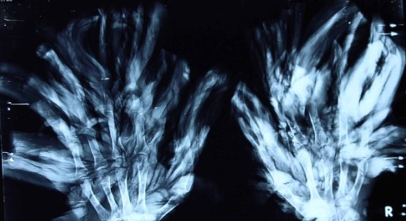
Epidermodysplasia verruciformis
Stephen Ortmann

Slide 2
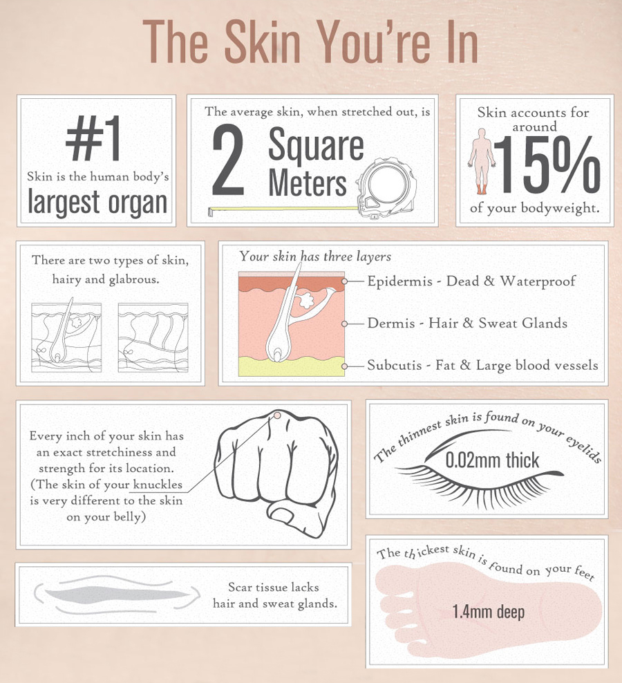
What is skin?

Slide 3
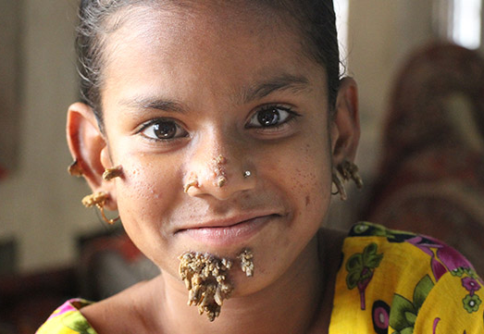
What are warts?

Slide 4
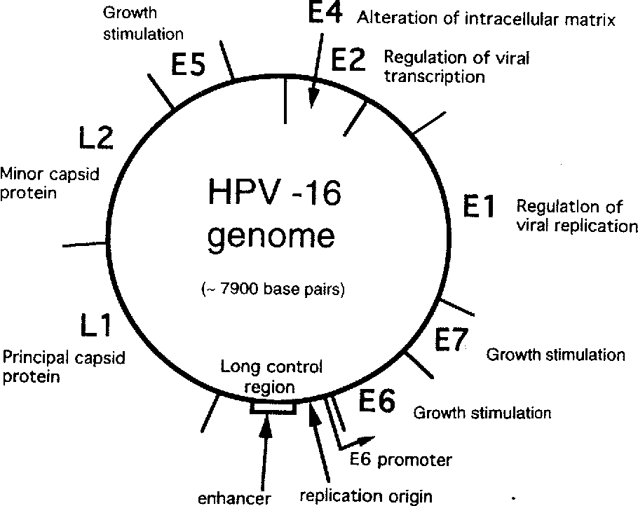
What is Human papillomavirus (HPV)?

Slide 5
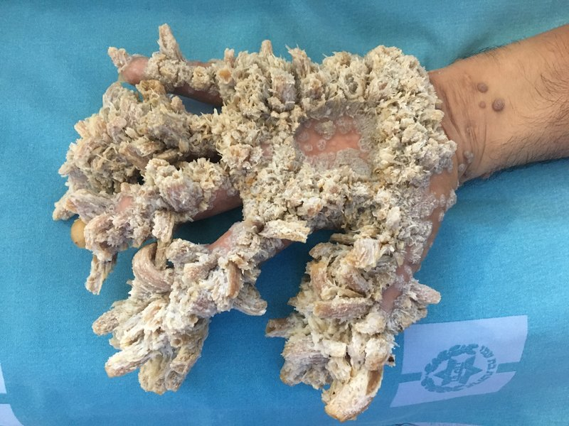
What is Epidermodysplasia verruciformis (EV)?

Slide 6
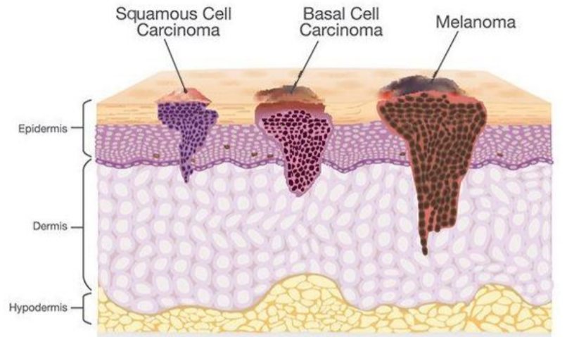
What are EV symptoms?

Slide 7
What genes are associated with EV?
TMC6
TMC8

Slide 8
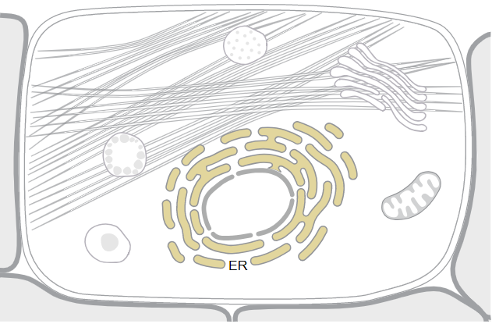
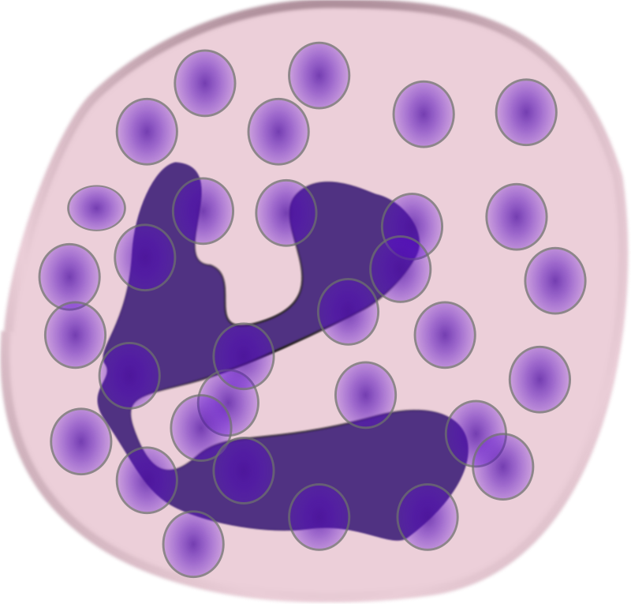
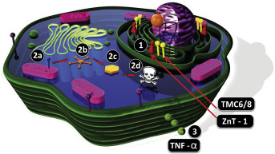
Gene ontology of Ever1
Cellular Component | Molecular Function | Biological Processes

Slide 9
How is Ever1 involved in EV?
Two Ideas!

Slide 10
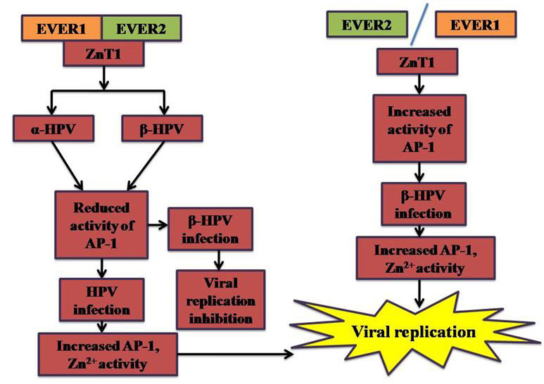
Dysregulation of Zinc concentrations

Slide 11
Destabilization of the CIB-1, EV1, EV2 complex

Slide 12
What is Calcium and integrin binding protein-1

Slide 13
What is TMC6 Phylogeny?

Slide 14
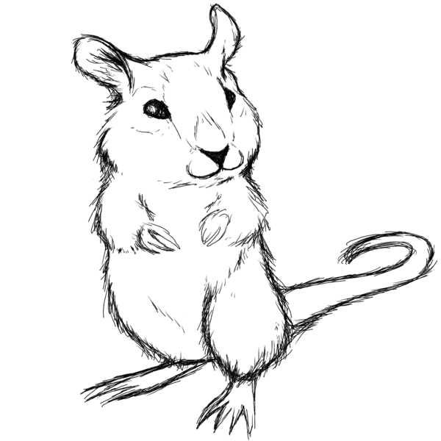
Why use mice?

Slide 15
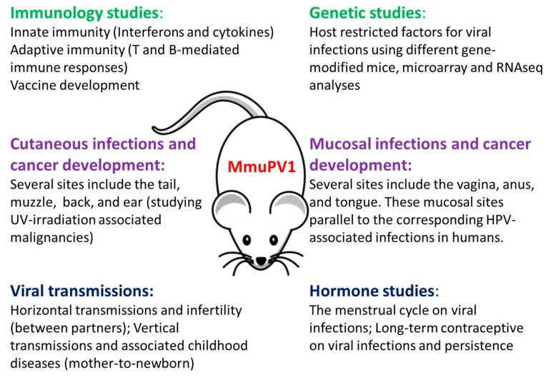
Why use mice?

Slide 16
TMC6 Homology?
Humans
Mice
Percent Identity = 75%!

Slide 17
What other proteins does TMC6 interact with?
Involved with Neutrophils and Integrin binding
Involved in Ubiquination
Involved in circadian rhythm

Slide 18
What other proteins does TMC6 interact with?
Direct line of interaction from TMC6 to Cib1
UBR4: Plays a role in Ubiquination
Cry2: Involved in the circadian rhythm and sensitive to blue-light

Slide 19
What don’t we know?

Slide 20
What don’t we know?
How do these proteins actually interact to stabilize CIB1?

Slide 21
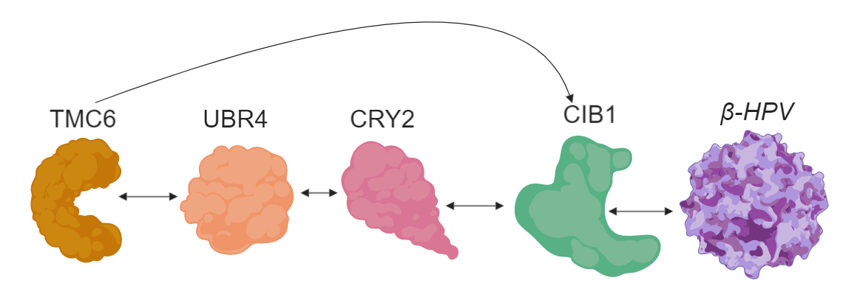
What is the primary goal?
To understand how TMC6 and CIB1 interact in normal keratinocytes and determine if it is direct or indirect

Slide 22
Study Design

Slide 23
Aim 1: Identify conserved domains on TMC6 and mutate them
TMC6 Mutant
CRISPR/Cas9
BLAST
Omega

Slide 24
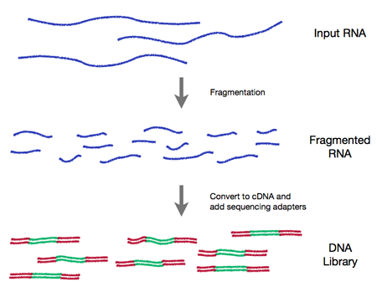
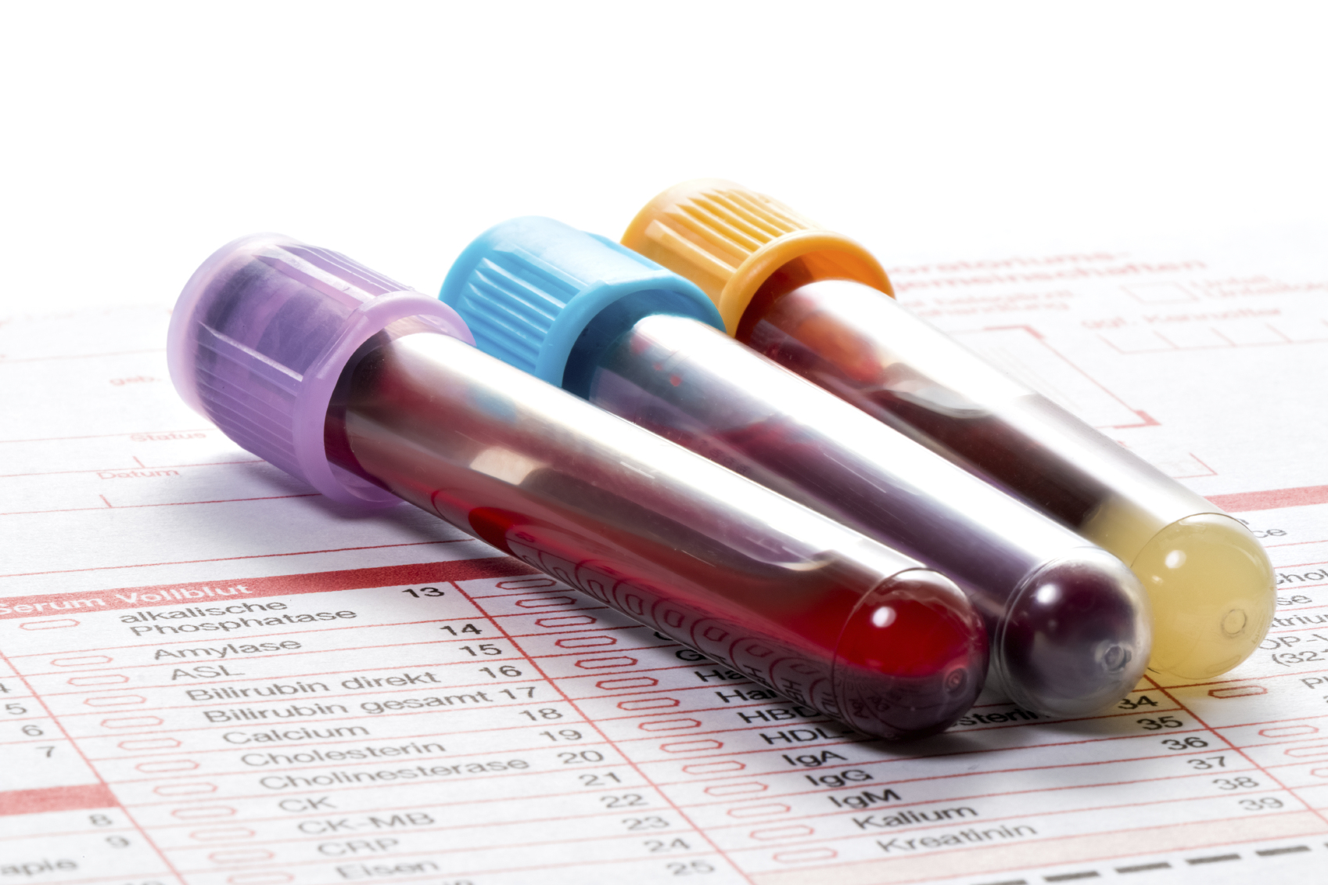
Aim 2: Determine expression levels of CIB1, CRY2, UBR4, TMC8, and Neutrophil levels in all groups

Slide 25
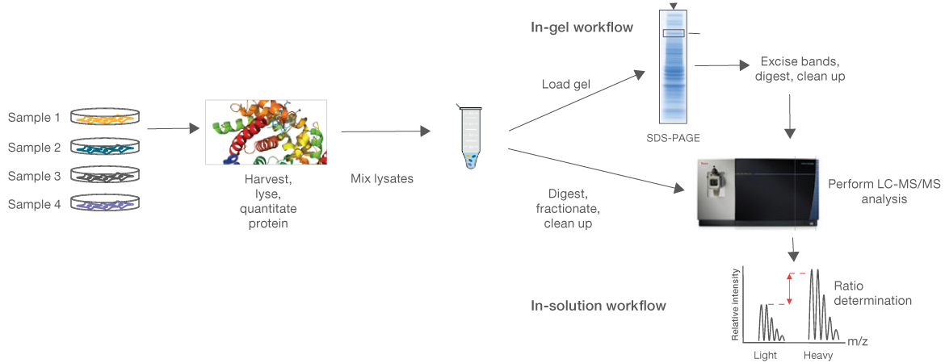
Aim 3: Determine how the phospho-proteome is different in EV tumors compared to control
Goal: To generate a proteomic map of differing expression levels to see if TMC6 interacts directly with CIB1

Slide 26
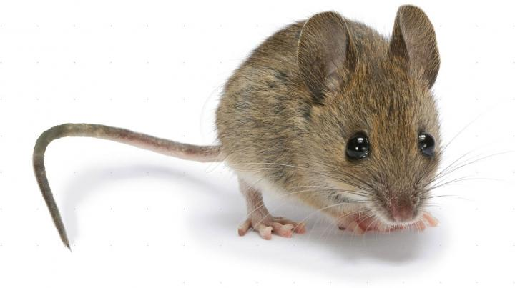
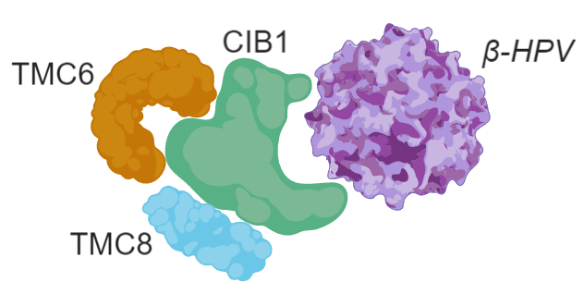
Conclusion
EV is a rare autosomal recessive disease that leads to persistent B-HPV infection, persistent scaly warts, and high susceptibility to develop SCC
A mouse model will be used to not only model HPV infection in keratinocytes, but also model SCC upon blue-light exposure
The goal of the project is to determine how TMC6 interacts with CIB1 to stabilize the complex and lead to B-HPV infection immunity

